Slide 1
Two-way coupling in NekRS

Slide 2
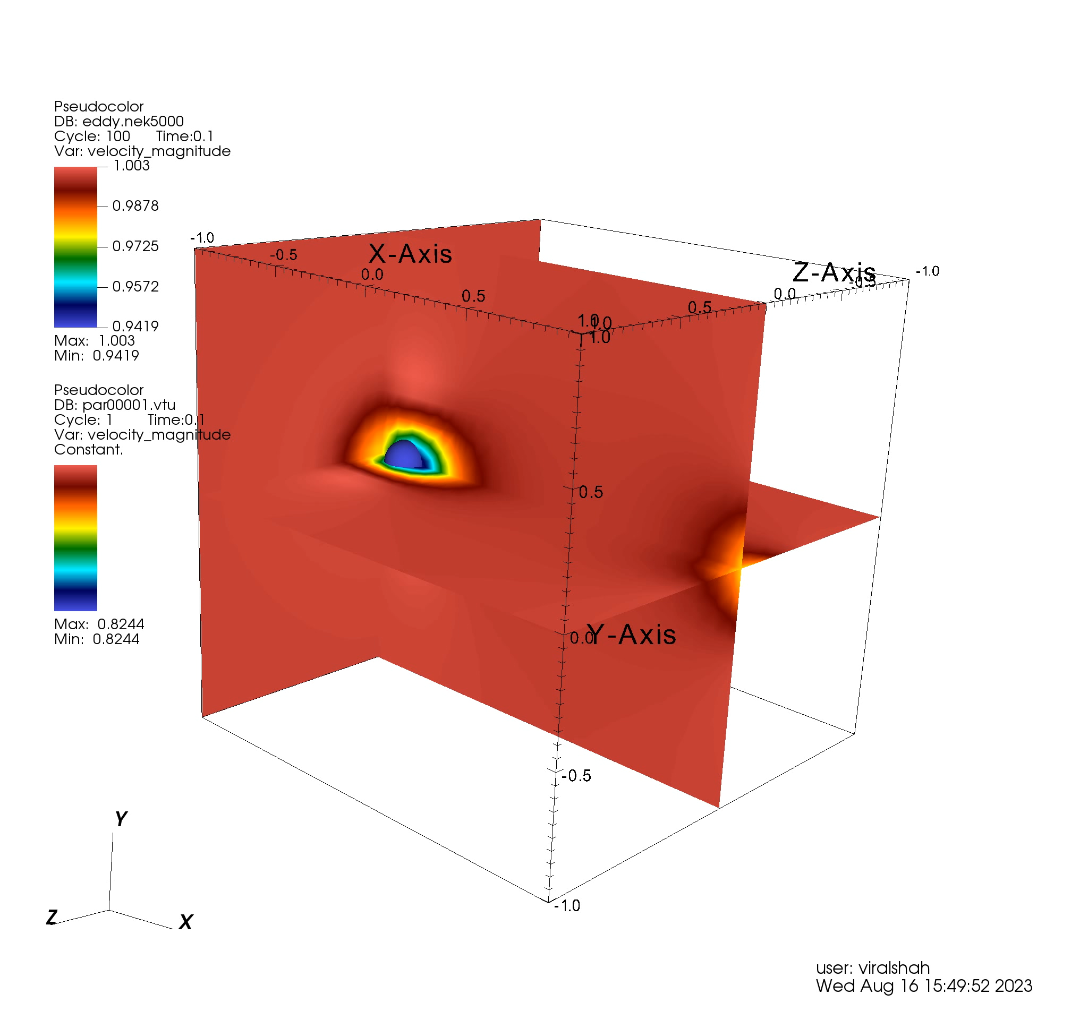
Single particle two-way coupling
BC: Periodic domain in all 3 directions
IC: Unit velocity in x-direction
Single particle moving periodically
Bin based approach (PPICLF)
2-GPU demo
- Can be scaled to multiple GPU

Slide 3
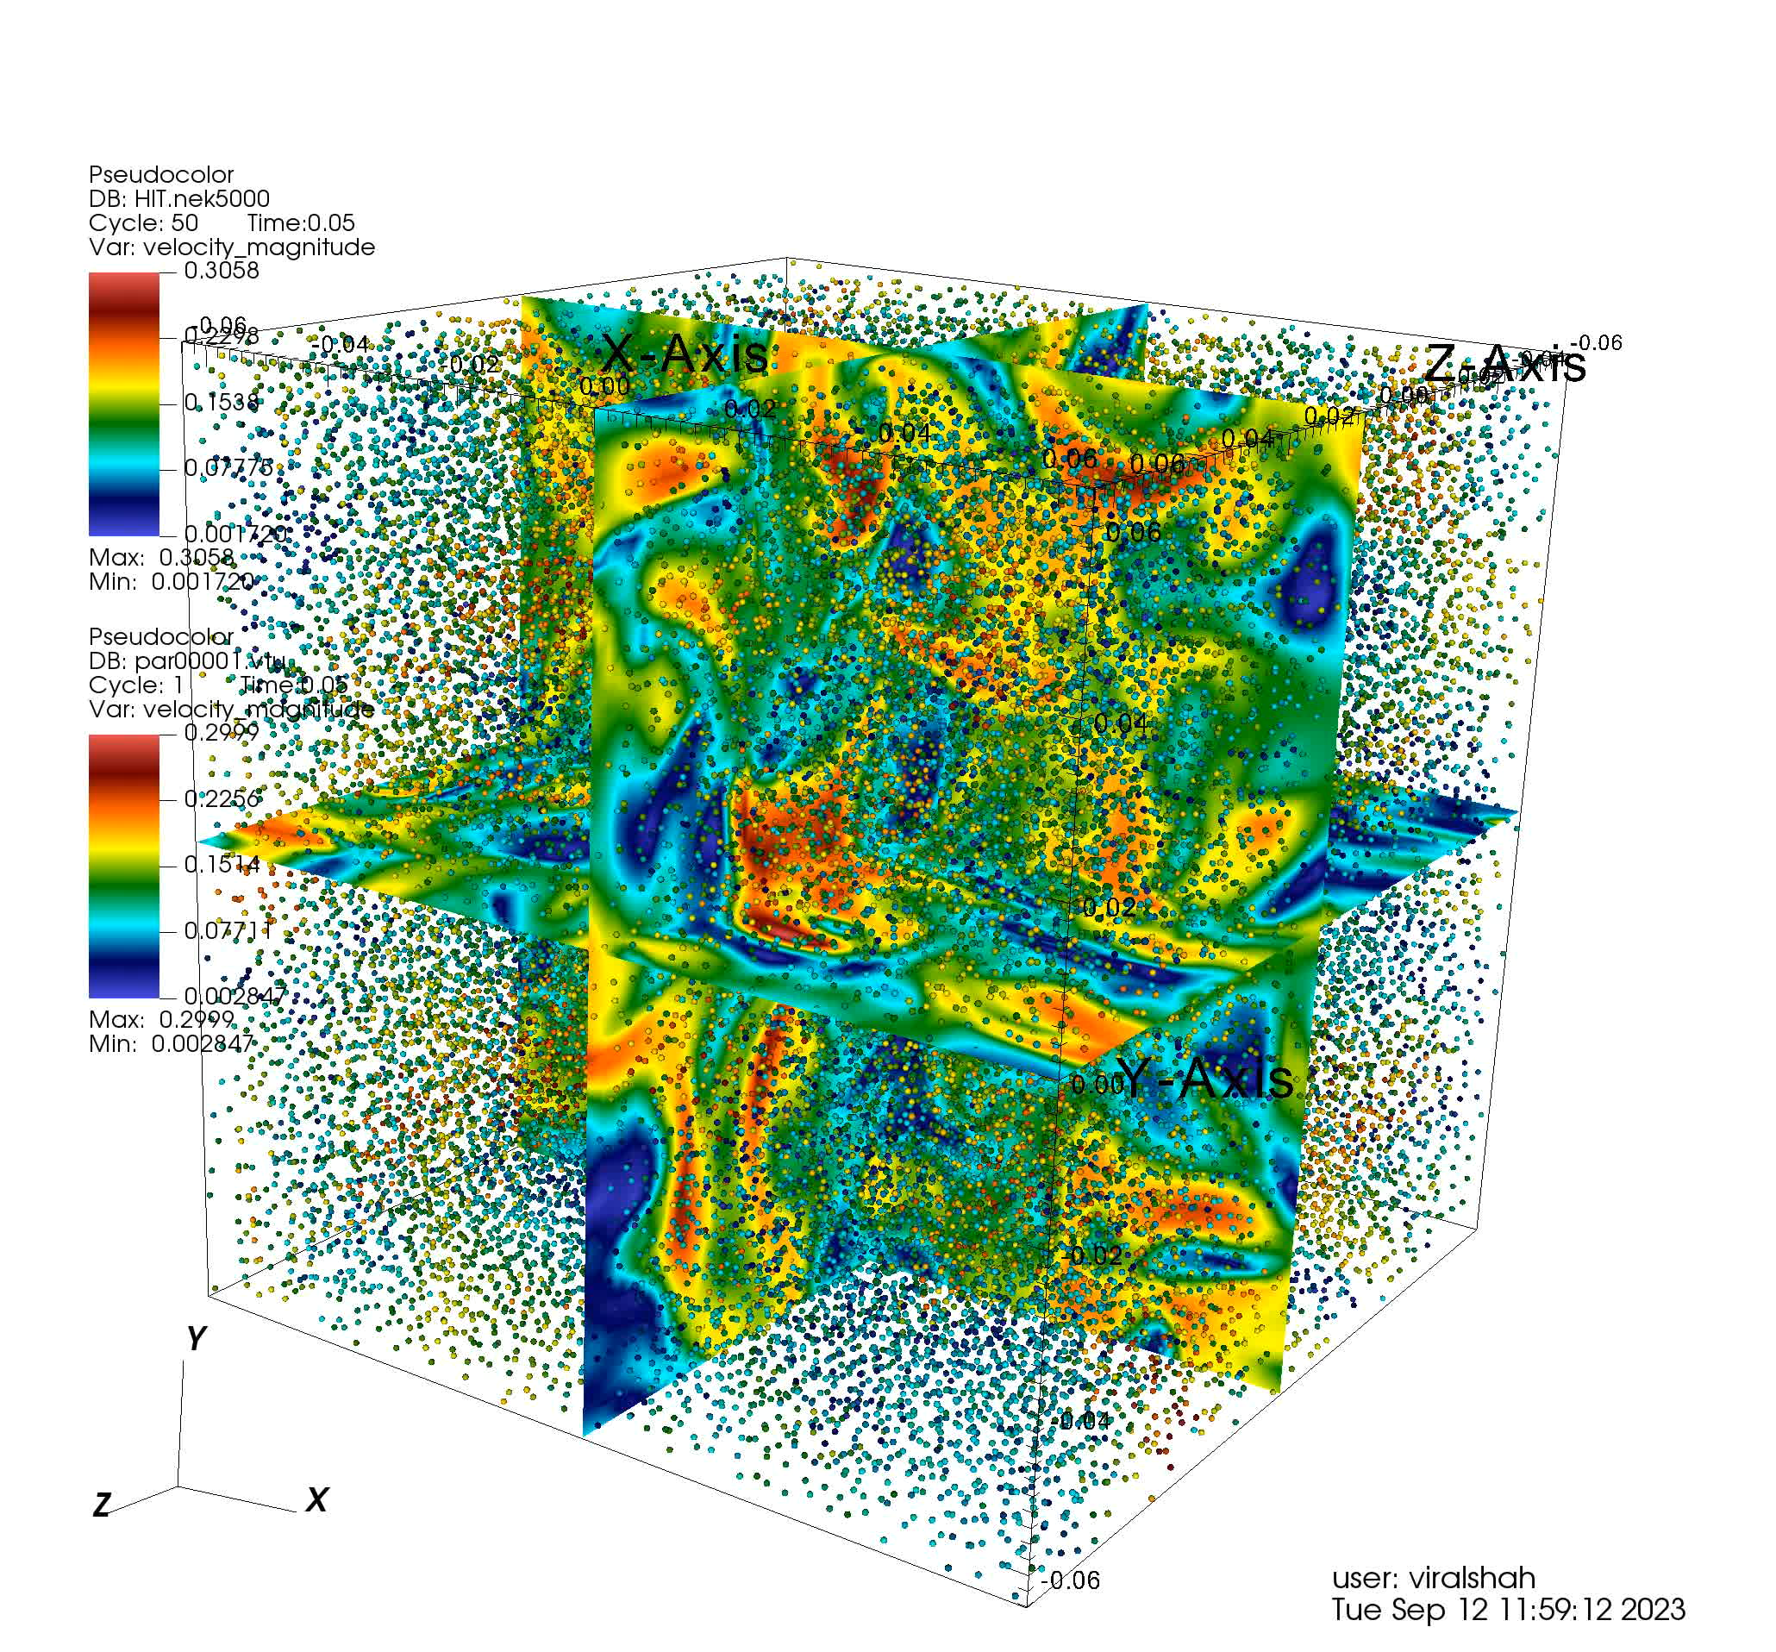
Two-way coupling (Homogeneous isotropic turbulence)
Triply periodic domain
N_{grid} = 512000 (80³)
N_{pts} = 46656 (36³)
Steps = 500
Case | Time (s)
Only fluid flow | 112
Default 1 way nekRS | 120
Bin based 1 way (Decoupling fluid and particle domain) | 130
Ghost particle creation and migration | 260
2 way without ghost particles | 712
2 way with ghost particles | 775

Slide 4
Current Approach
Identify the processor bounding limits.
Mark particles within a radius of influence of the bounding limits
The particle is then shifted appropriately by assigning an id to the shifting direction. (there are 26 possible direction currently)
If the particle needs to be supplied to different processors a copy is created for each with a different shifting direction. (7 different ones at max would be assigned to a single particle)
The shifted particles are identified by findfpts in the respective processors and their original position is recovered by the direction id

Slide 5
Two-way coupling (Homogeneous isotropic turbulence)
Triply periodic domain
N_{grid} = 512000 (80³)
N_{pts} = 46656 (36³)
Steps = 500
Case | Time (s)
Only fluid flow | 112
Default 1-way nekRS | 120
2-way without ghost particles | 148
Ghost particle creation and migration (no 2-way coupling) | 247
2-way with ghost particles | 282

Slide 6
Advantages
Drawbacks
Avoid decoupling of fluid and particle domain
No mesh points required separately so avoids communication involved with the same
Ghost particles creation still occurs on CPU which consumes time.
Works good for box geometries as the bounding limits correspond to element edges. This is not true for general geometries.
Irregular partitioning can cause potential issues.
Future development
Reduce the possible direction from 26 to 8
Take care of the irregular partitioning,
(Involves creating copies in all direction for faster distribution and then identifying and removing duplicates)

